Slide 1
Chapter 3. Interpolation and Approximation

Slide 2
Interpolation and Approximation
Linear interpolation
Lagrange interpolation
Newton interpolation
Spline interpolation
Least-squares approximation

Slide 3

What is interpolation?
Interpolation is needed when we want to infer some local information from a set of incomplete or discrete data.
trajectory of a golf ball/football/missile/....

Slide 4
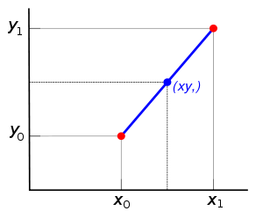
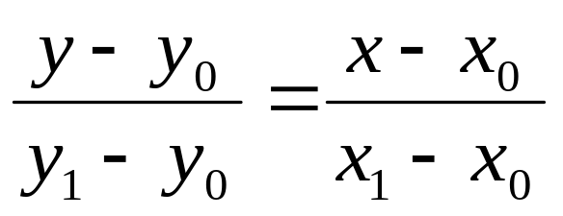
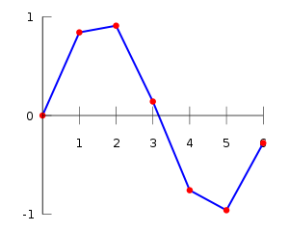
Interpolation between two points
Linear interpolation
y=y(x)
More points:
Direct connections between two nearest neighbor points.

Slide 5
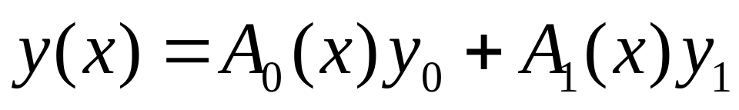
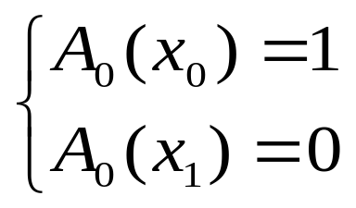
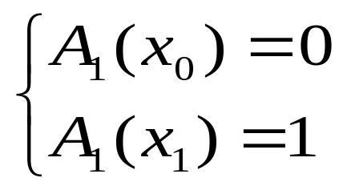
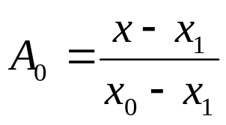
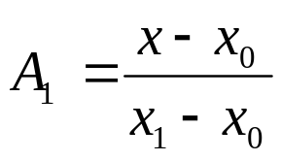
More smooth interpolation
Lagrange interpolation
Let's start from the simplest case:
(x₀,1)
(x₁,1)
(x₁,0)
(x₀,0)

Slide 6
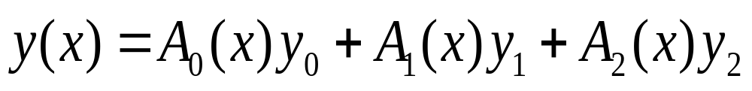
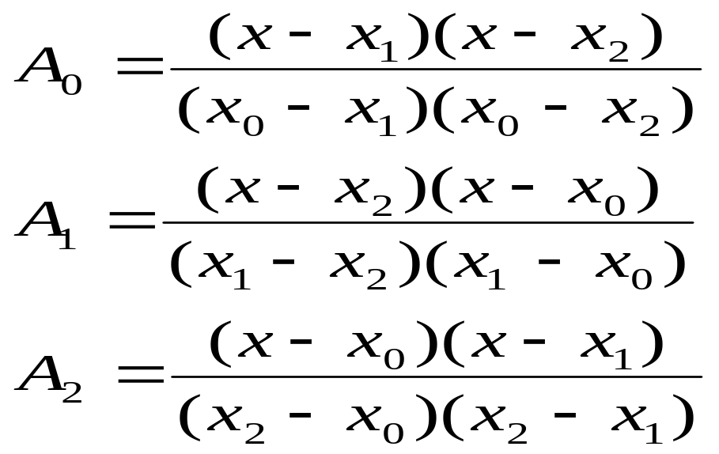
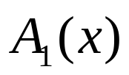
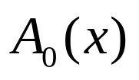

Lagrange interpolation - Three points
Y
y₁
y₂
y₀
y=f(x)
X
O
x₀
x₁
x₂
1
1
1
x₀
x₁
x₂
x₀
x₁
x₂
x₀
x₁
x₂

Slide 7
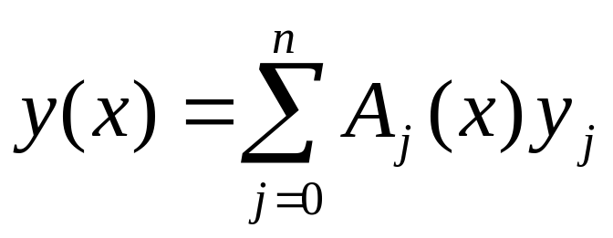
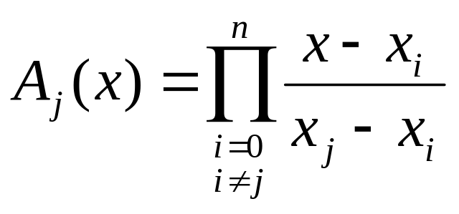
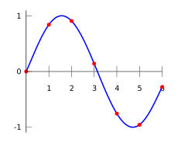
Lagrange interpolation - a general formula
In general, for n+1 points:
The principle
x=x_{j} | A_{j}(x)=1
x=x_{i} (i!=j) | A_{j}(x)=0

Slide 8
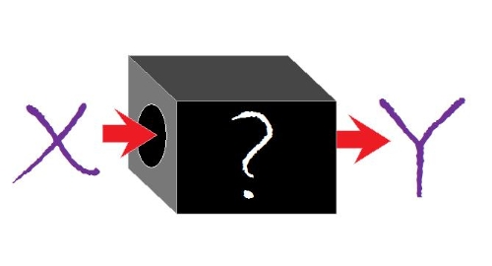
How to write a code?
A subroutine
Inputs: (x_{j}, y_{j}), and x
Output: y(x)
Algorithm in the black box:
To calculate the coefficient A_{j}(x)
Then we can obtain:

Slide 9

Code example
double interpolate(const double x[], const double y[],const int n,const double xx)
{
// n+1: total points
// x[ ]: array of xi
// y[ ]: array of yi
// xx: x in y(x)
double yx=0; //y=y(x)
for(int j=0;j<=n;j++) //Aj*yj
{
double aj=1; //Aj
for(int i=0;i<=n;i++)
{
if(i!=j)
{
aj*=(xx-x[i])/(x[j]-x[i]);
}
}
yx+=aj*y[j]; //Sum(Aj*yj)
}
return yx;
}

Slide 10
Code example
10 equal spacing points of cos(x) within [0,π]: 0, π/10, ...... 9π/10, π,
LagrangeInterpolation.cpp

Slide 11
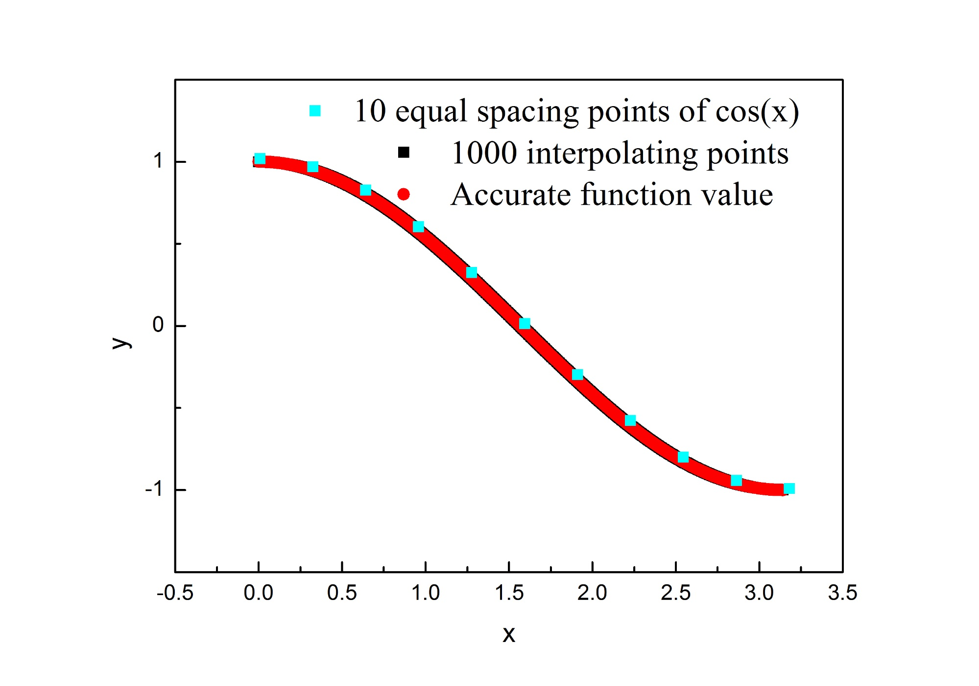
Results

Slide 12
Drawback
If one more point is added, all coefficients have to be recalculated.
Any possible improvement?
An alternative algorithm: Newton interpolation!

Slide 13
Newton Interpolation
The fact is:
y(x)=f₀+f₁x+f₂x²+f₃x³+f₄x⁴......+f_{n}x^{n}
a polynomial function. n order for n+1 points
Another expression of the polynomial function
Given points: (x₀, y₀), (x₁, y₁), (x₂, y₂) ...... (x_{n}, y_{n})
Then the task is to calculate each a_{i}, which only depends on the first i+1 points.
If one more point is added, we only need to calculate a_{n+1}.

Slide 14
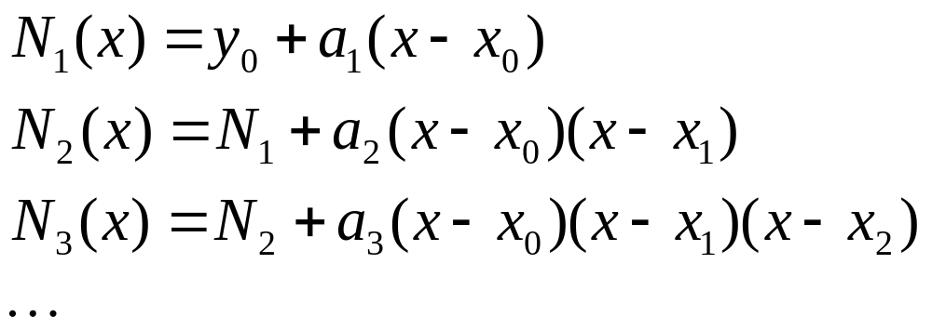
Calculation of a_{i}
N₁(x₁)=y₁ ----> a₁: [y₁-y₀]/(x₁-x₀)
N₂(x₂)=y₂ ---> a₂: [y₂-N₁(x₂)]/[(x₂-x₀)(x₂-x₁)]
N₃(x₃)=y₃ ---> a₃: [y₃-N₂(x₃)]/[(x₃-x₀)(x₃-x₁)(x₃-x₂)]
.....

Slide 15
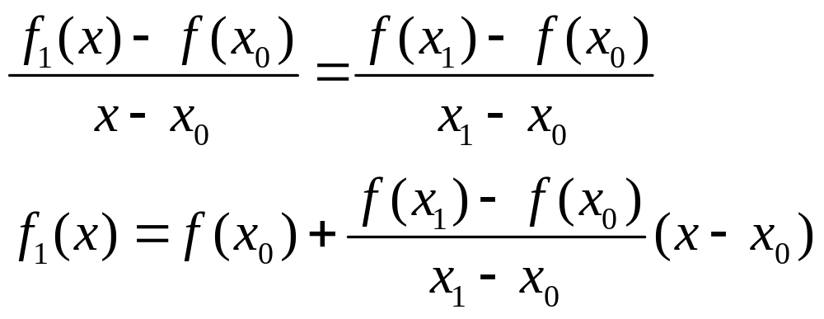
Newton divided difference formula
Linear Interpolation
Is the simplest form of interpolation, connecting two data points with a straight line.
f₁(x) designates that this is a first-order interpolating polynomial.
Slope and a finite divided difference approximation to 1st derivative
Linear-interpolation formula

Slide 16
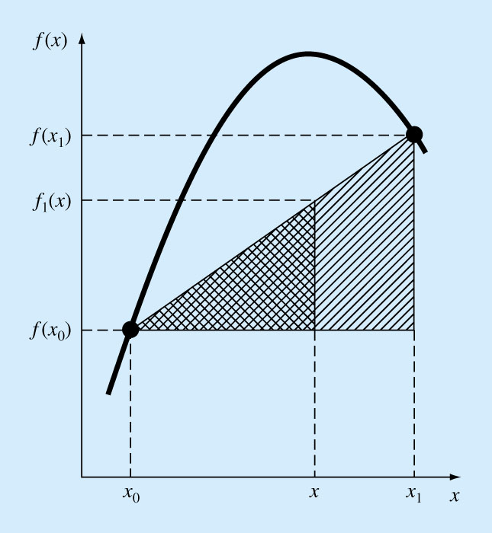

Slide 17
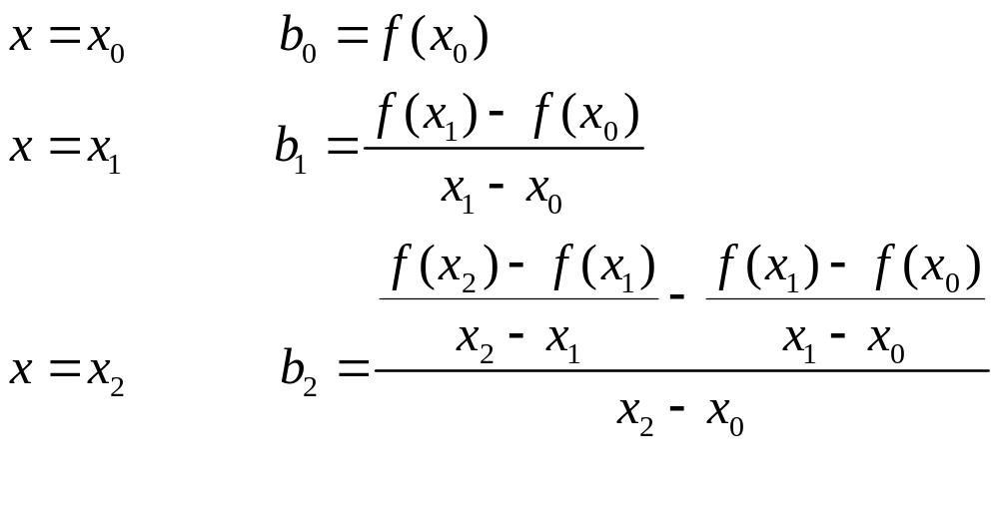
Quadratic Interpolation
If three data points are available, the estimate is improved by introducing some curvature into the line connecting the points.
A simple procedure can be used to determine the values of the coefficients.

Slide 18
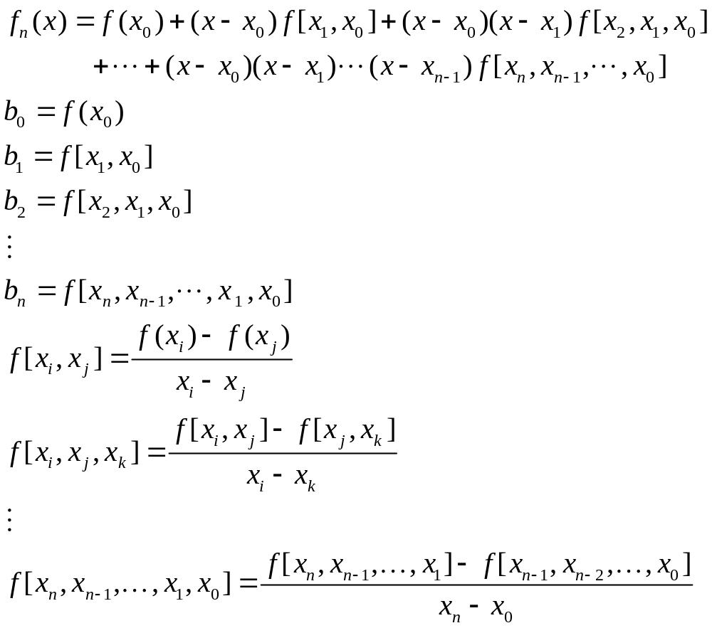
General Form of Newton’s Interpolating Polynomials
Bracketed function evaluations are finite divided differences
Chapter 18
https://people.sc.fsu.edu/~jburkardt/f_src/newton_interp_1d/newton_interp_1d.html

Slide 19
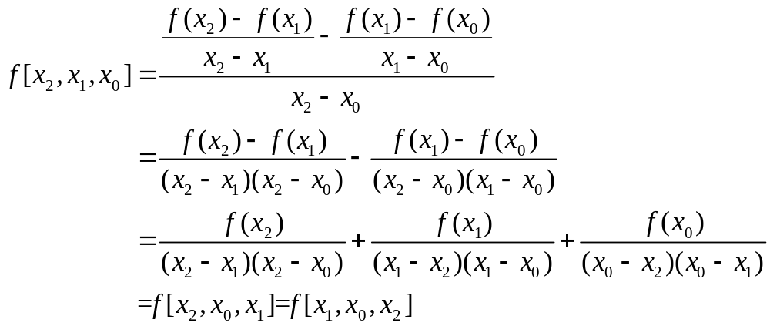
Invariance Theorem
The divided difference f[x_{0,} x_{1,} …, x_{k}] is invariant under all permutations of the x_{i}‘s.
Example:
Invariant under any permutations of x_{i}

Slide 20
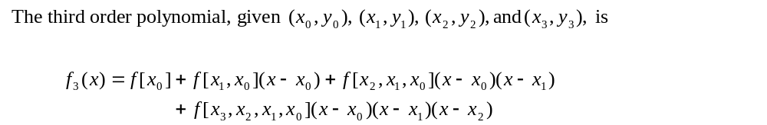
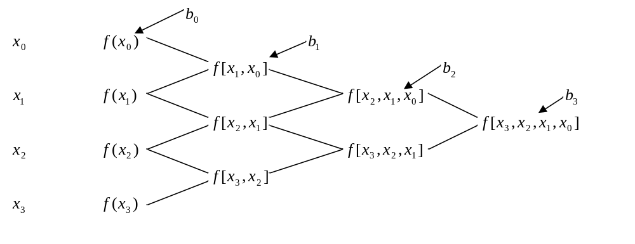
Example

Slide 21
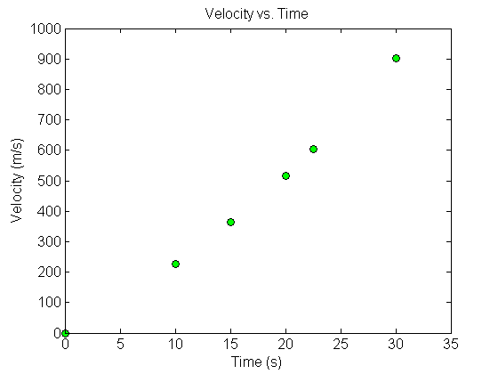



The upward velocity of a rocket is given as a function of time in Table 1. Find the velocity at t=16 seconds using the Newton Divided Difference method for cubic interpolation.
Table. Velocity as a
function of time
0 | 0
10 | 227.04
15 | 362.78
20 | 517.35
22.5 | 602.97
30 | 901.67
Figure. Velocity vs. time data
for the rocket example

Slide 22

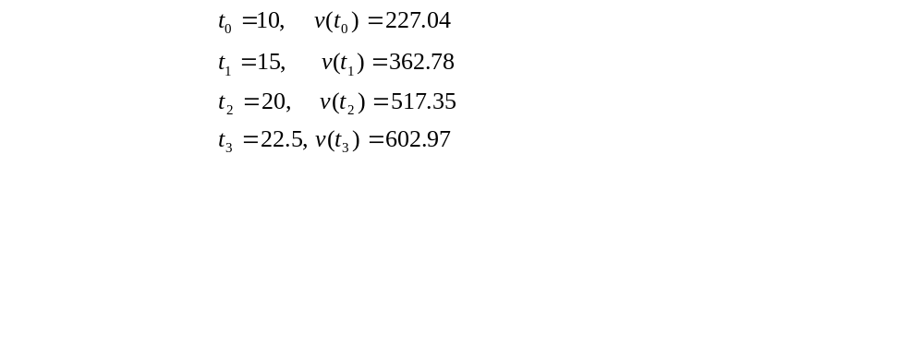
The velocity profile is chosen as
we need to choose four data points that are closest to

Slide 23
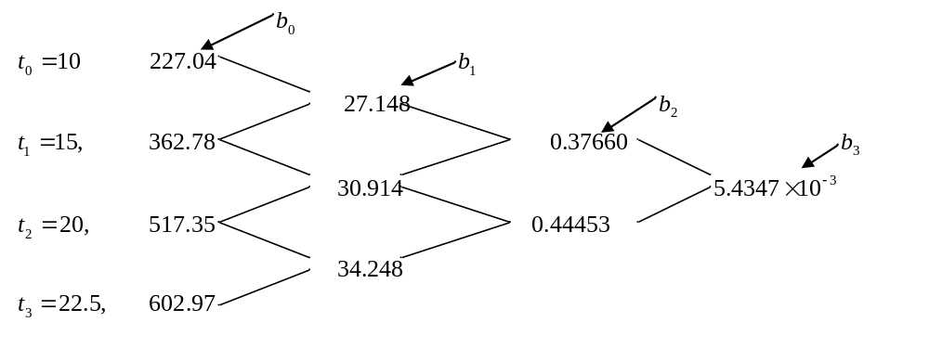
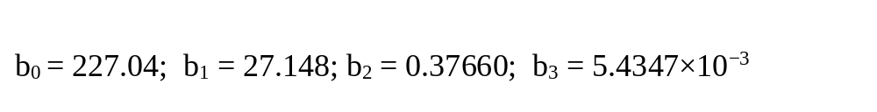

Slide 24
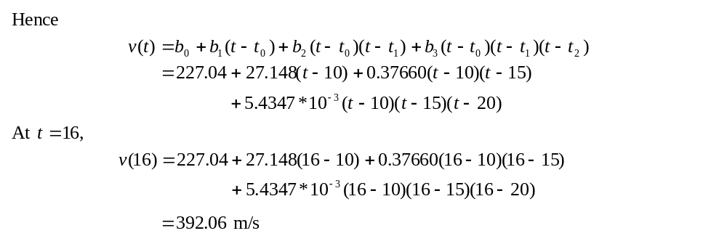

Slide 25
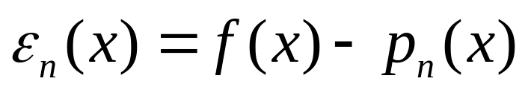
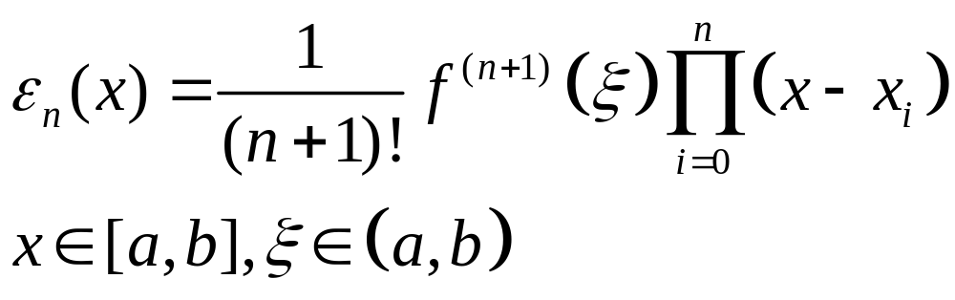
Error in polynomial interpolation
Define the error term as:

Slide 26
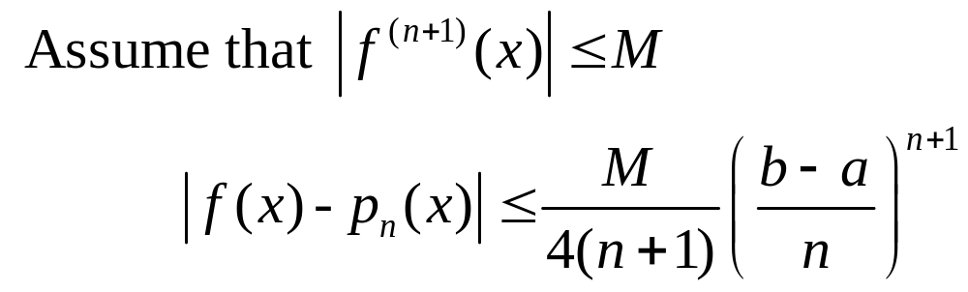
If the n+1 points are equally spaced between [a,b],

Slide 27
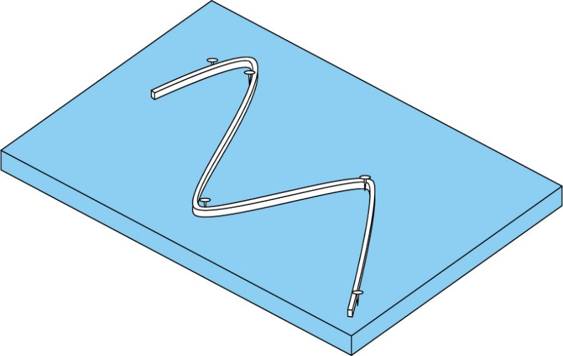
Spline Interpolation
Polynomials are the most common choice of interpolants.
There are cases where polynomials can lead to erroneous results because of round off error and overshoot.
Alternative approach is to apply lower-order polynomials to subsets of data points. Such connecting polynomials are called spline functions.

Slide 28
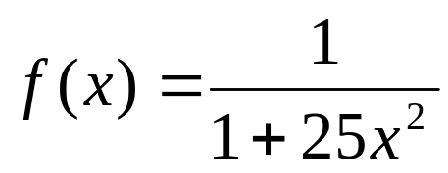
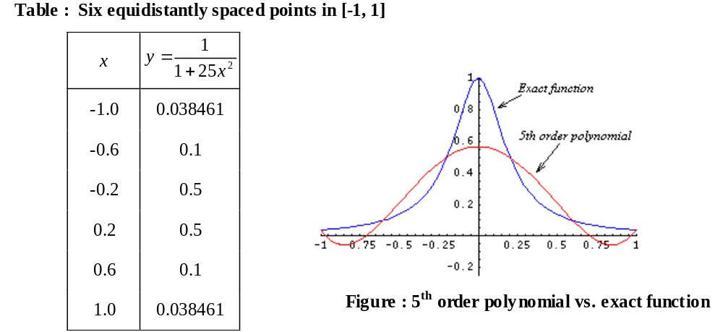
Why Splines?

Slide 29
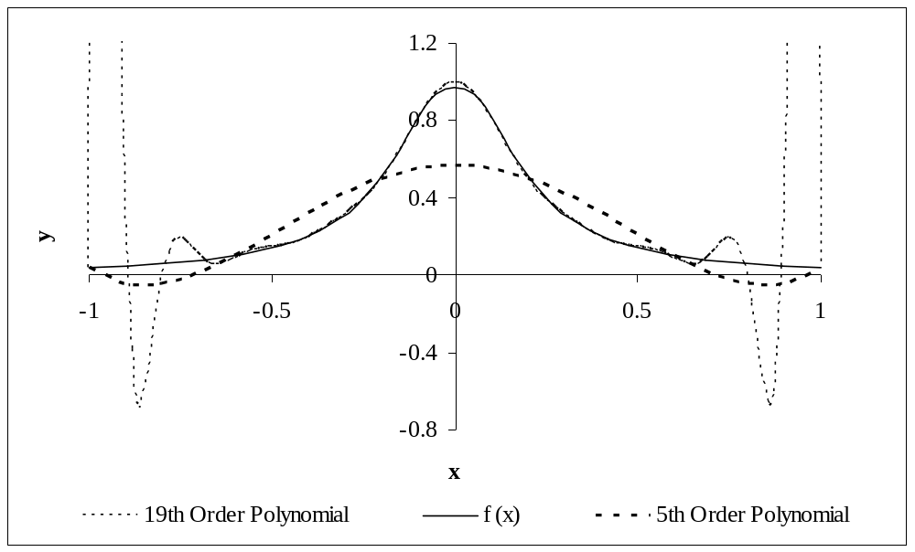
Figure: Higher order polynomial interpolation is a bad idea
Runge's phenomenon
See https://en.wikipedia.org/wiki/Runge%27s_phenomenon

Slide 30
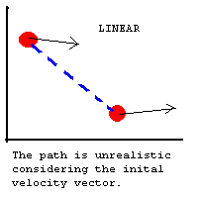
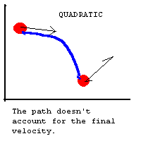
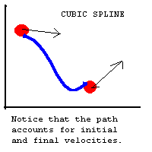
Spline Interpolation
Linear, Quadratic, Cubic
  Preferred over other polynomial interpolation
    More efficient
      High-degree polynomials are very computationally expensive
      Smaller error
      Interpolant is smoother

Slide 31
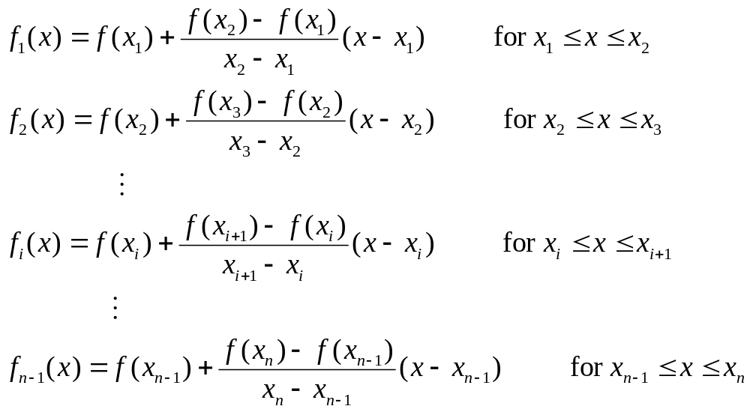
Linear Splines (First-order Spline)

Slide 32
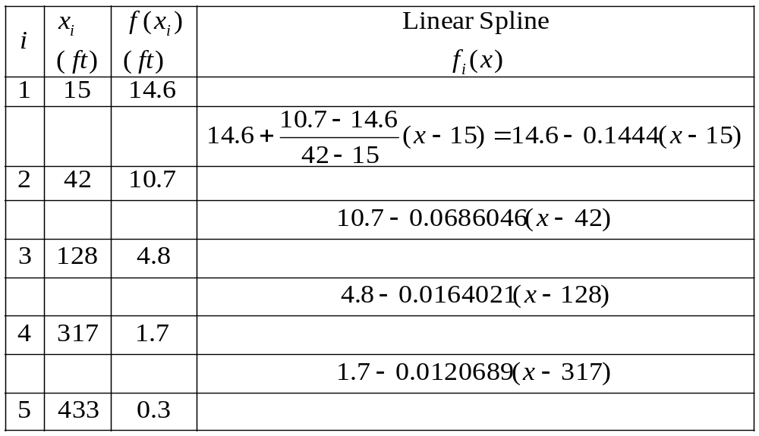
Example: data-1

Slide 33
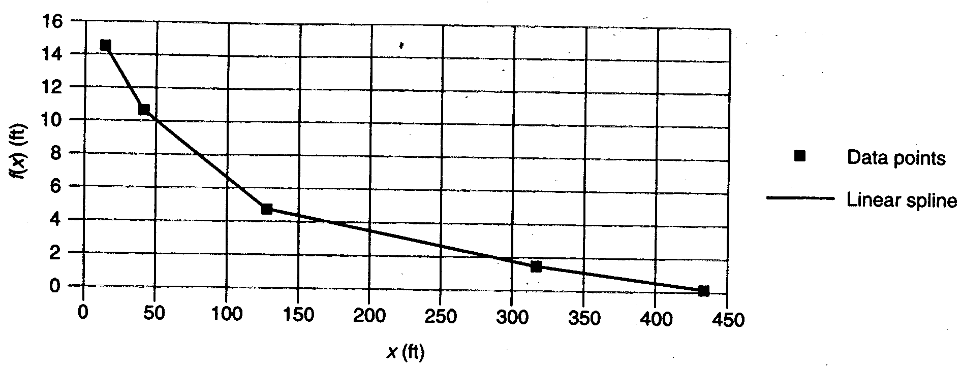

Slide 34
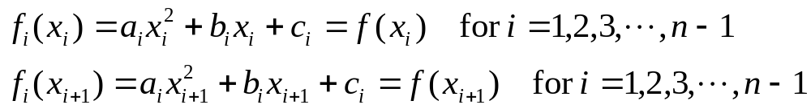
Quadratic Splines
(Second-order Splines)
The general form of a quadratic equation between (x_{i},f(x_{i})) and (x_{i+1},f(x_{i+1})) (in total n points):
Every two adjacent data points have an interpolation equation as above.
Rule 1: The splines must pass through the data points.
2n-2 equations

Slide 35
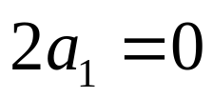
Rule 2: At one interior point, the first derivatives (slope) of the two interpolation functions representing it must be equal.
Rule 3: The second derivative for the spline between the first two data points is zero. That is, the function should be linear.
The above equations provide 3(n-1) conditions to solve the 3(n-1) unknowns a_{i}, b_{i}, c_{i}, i=1,2, …, n-1.
n-2 equations
1 equation

Slide 36
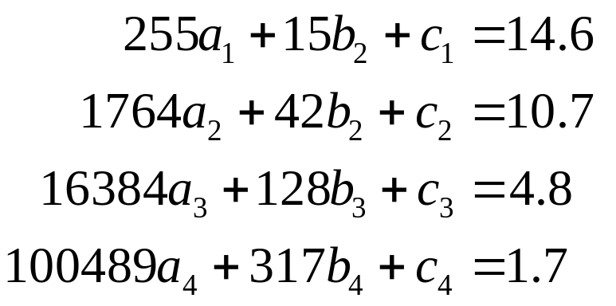
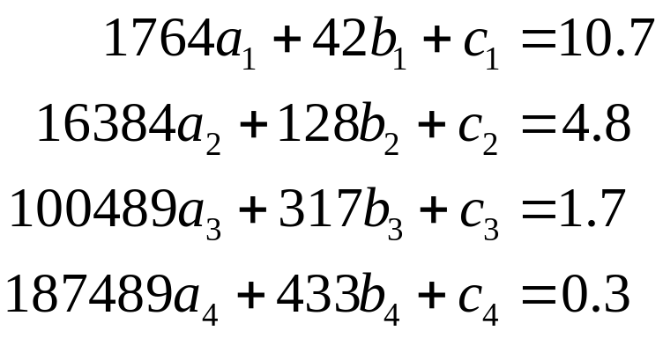
Example: Quadratic Spline for data-1
By rule 1 (a):
By rule 1(b):

Slide 37
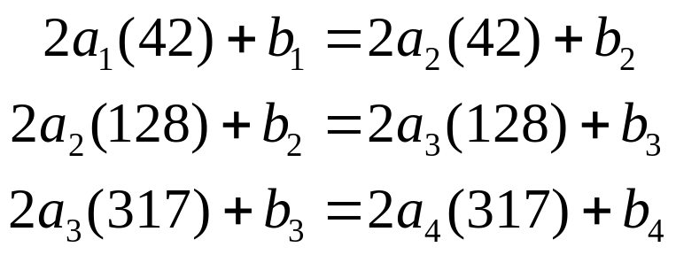

By rule 2:
By rule 3:

Slide 38
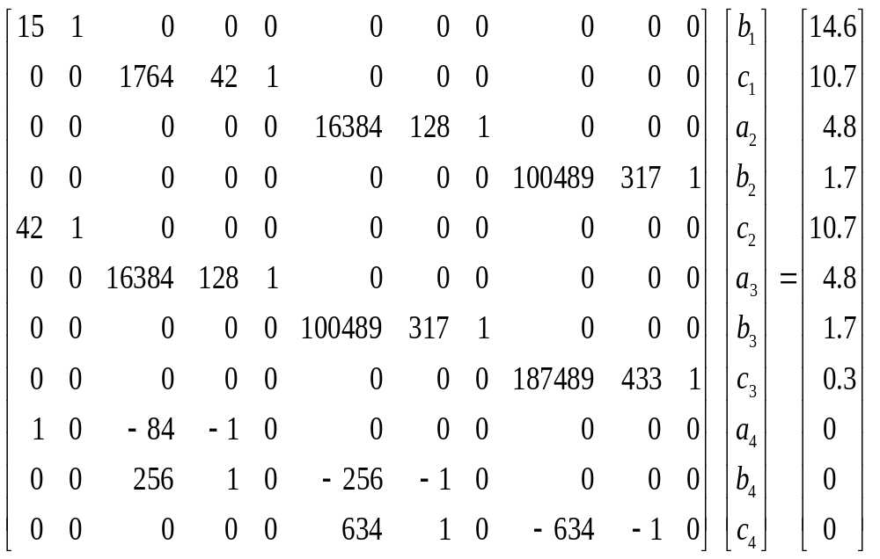

Slide 39
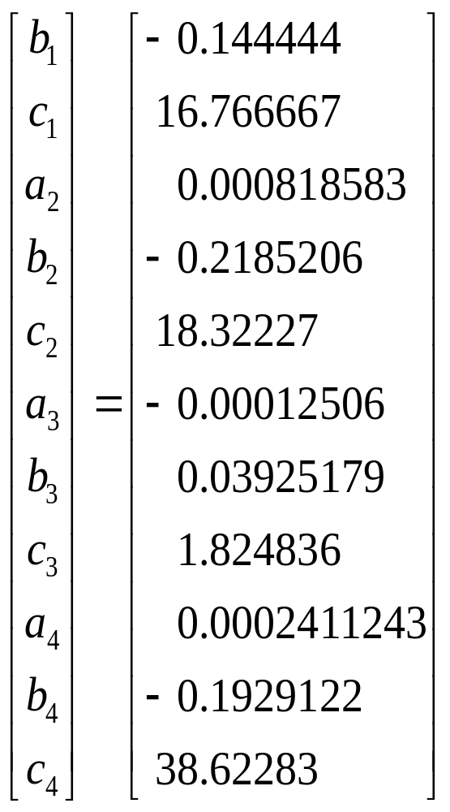
The solution of the system of the equations:

Slide 40

Figure: Quadratic Spline for data-1

Slide 41

Cubic Splines (Third-order Spline)
The general form of a cubic equation between (x_{i},f(x_{i})) and (x_{i+1},f(x_{i+1})) :
Every two adjacent data points have an interpolation equation as above.
Rule 1: The splines must pass through the data points.
2n-2 equations

Slide 42


Rule 2: At one point, the first derivatives (slopes) of the two interpolation functions representing it must be equal.
Rule 3: The second derivatives must be equal at the interior points.
n-2 equations
n-2 equations

Slide 43

Rule 4: The second derivatives for the spline at the first and last data points are zero.
The above equations provide 4(n-1) conditions to solve the 4(n-1) unknowns a_{i}, b_{i}, c_{i}, d_{i}, i=1,2, …, n-1.
Higher-order splines can be developed similarly. However, the computational difficulty greatly increases by needing to solve larger system of simultaneous equations.
2 equations
Natural cubic spline

Slide 44

Alternative technique to get Cubic Splines
The second derivative within each interval [x_{i-1,} x_{i} ] is a straight line. (the 2nd derivatives can be represented by first order Lagrange interpolating polynomials.
A straight line connecting the first knot f’’(x_{i-1}) and the second knot f’’(x_{i})
The second derivative at any point x within the interval

Slide 45


Cubic Splines
The former equation can be integrated twice
2 unknown constants of integration can be evaluated by applying the boundary conditions:
1. f(x) = f (x_{i-1}) at x_{i-1}
2. f(x) = f (x_{i}) at x_{i}
Unknowns:
i = 1,…, n

Slide 46


Cubic Splines
For each interior point x_{i} (in total n-2):
This equation result with n-2 unknown second derivatives where, for boundary points:
f˝(x₁) = f˝(x_{n}) = 0
tridiagonal equations: use Thomas algorithm

Slide 47
Cubic Splines - Example
Fit the following data with cubic splines
Use the results to estimate the value at x=5.
Solution:
Natural Spline:
x | 3.0 | 4.5 | 7.0 | 9.0
f(x) | 2.5 | 1.0 | 2.5 | 0.5

Slide 48




Cubic Splines - Example
For 1st interior point (x₁ = 4.5)
-
-
-
Apply the following equation:
x | 3.0 | 4.5 | 7.0 | 9.0
f(x) | 2.5 | 1.0 | 2.5 | 0.5

Slide 49





Cubic Splines - Example
Since
For 2nd interior point (x₂ = 7 )
x | 3.0 | 4.5 | 7.0 | 9.0
f(x) | 2.5 | 1.0 | 2.5 | 0.5

Slide 50


Cubic Splines - Example
Apply the following equation:
Since

Slide 51


Cubic Splines - Example
Solve the two equations:
The first interval (i=1), apply for the equation:

Slide 52


Cubic Splines - Example
The 2nd interval (i =2), apply for the equation:
The 3rd interval (i =3),
For x = 5:

Slide 53





tridiagonal equations: use Thomas algorithm
Question: other boundary conditions?

Slide 54
Guidelines for Choice of Interpolation Method
Both the Gregory-Newton and Lagrange polynomial interpolation methods eliminate the need to solve a set of simultaneous equations. Of the two methods, the Lagrange polynomial scheme is perhaps the easier to program. Although both of these methods (as well as the method of undetermined coefficients) work with unequally spaced data points, the best accuracy is usually achieved when the differences in the spacing of the data points are minimal.
Interpolation using splines can be more accurate than other methods, especially in cases where the data show large sudden changes.

Slide 55
Least-squares approximation
Interpolation is mainly used to find the local approximation of a given discrete set of data.
In many situations in physics, we need to know the global behavior of a set of data in order to understand the trend in a specific measurement or observation:----> Overall approximation or fitting
A typical example is a polynomial fit to a set of experimental data with error bars.

Slide 56


Slide 57
Process
What do we have?
A fitting function p(x) vs the data (x_{i},y_{i}).
p(x) is close to but may not pass through (x_{i},y_{i}). The differences between p(x_{i}) and y_{i} are the error bars.
The aim is to reduce the error bars to a minimum level by adjusting the coefficients of p(x) .

Slide 58


Example: p(x) is a mth-order polynomial
m+1 variables
for discrete data
n>m, or the error bars can be zero

Slide 59


To minimize the error bars.
We get m+1 linear equations.
Then solve the linear system for a_{k}.
The simplest example: linear fitting

Slide 60



By calculating the partial derivative

Slide 61

Johann Carl Friedrich Gauss
A German mathematician who contributed significantly to many fields, including number theory, algebra, statistics, analysis, differential geometry, geodesy, geophysics, mechanics, electrostatics, astronomy, matrix theory, and optics.
Referred to as the Prince of Mathematicians and greatest mathematician since antiquity.
1777-1855
Notes:
1801年，意大利天文学家朱赛普·皮亚齐发现了第一颗小行星谷神星。经过40天的跟踪观测后，由于谷神星运行至太阳背后，使得皮亚齐失去了谷神星的位置。随后全世界的科学家利用皮亚齐的观测数据开始寻找谷神星，但是根据大多数人计算的结果来寻找谷神星都没有结果。时年24岁的高斯也计算了谷神星的轨道。奥地利天文学家海因里希·奥尔伯斯根据高斯计算出来的轨道重新发现了谷神星。高斯使用的最小二乘法的方法发表于1809年他的著作《天体运动论》中。法国科学家勒让德于1806年独立发明“最小二乘法”，但因不为世人所知而默默无闻。二乘法勒让德曾与高斯为谁最早创立最小二乘法原理发生争执。1829年，高斯提供了最小二乘法的优化效果强于其他方法的证明，因此被称为高斯-马尔可夫定理。

Slide 62


Robert Andrews Millikan
In 1910, Millikan published his famous work on the oil drop experiment in Science. Based on the measurements of the charges carried by all the oil drops, Millikan concluded that the charge carried by any object is a multiple (with a sign) of a fundamental charge, the charge of an electron (for negative charges) or the charge of a proton (for positive charges).
1868 – 1953
President of the California Institute of Technology
President of the American Physical Society
for his work on the elementary charge of electricity and on the photoelectric effect (1923)

Slide 63


The Millikan experiment
Input data
Fitting equation: q_{k}=k*Q_{e}+Q₀
Output: Q_{e} & Q₀
Millikan’s original oil-drop apparatus, 1909-1910

Slide 64
Code example
void Millikan(const double k[], const double q[],const int n)
{
// n: total points
// k[ ]: array of k
// q[ ]: array of q
double c[4]={0,0,0,0}; //coefficients
for(int i=0;i<n;i++)
{
c[0]+=k[i];
c[1]+=k[i]*k[i];
c[2]+=q[i];
c[3]+=k[i]*q[i];
}
const double q0=(c[0]*c[3]-c[1]*c[2])/(c[0]*c[0]-n*c[1]);
const double qe=(c[0]*c[2]-n*c[3])/(c[0]*c[0]-n*c[1]);
cout<<"The elementary charge is:\t"<<qe<<endl;
}

Slide 65
Code example
2.2.Millikan.cpp

Slide 66

Multiple Linear Model
The model:
p = # of predictor variables
X_{i} = ith predictor variable
b_{i} = partial regression coefficient
b₀= intercept coefficient
Y= criterion variable
It is better that n ≥ 4 p, where n is the number of observations.

Slide 67



The objective function (least-squares principle):
Consider p=2:

Slide 68


Solving the 3 simultaneous equations, we can get the values of b₀, b₁, and b₂.

Slide 69
Normal Equations
How do we solve Ax = b?
Least squares: arg min_{x} ║Ax-b║²
E = ║Ax-b║² = (Ax-b)^{T}(Ax-b)
= x^{T}A^{T}Ax – 2x^{T}A^{T}b – b^{T}b
∂E/∂x = 2(A^{T}A)x – 2A^{T}b = 0
(A^{T}A)x = A^{T}b normal equations
x = [(A^{T}A)⁻¹A^{T}]b pseudoinverse

Slide 70

Solving least-squares systems with SVD
We tried to solve Ax=b when A was rectangular:
Seeking solutions in least-squares sense:
A
x
b
=

Slide 71


When A is full-rank,
(normal equations)
So:
σ₁
σ₁
σ₁²
=
σ_{n}
σ_{n}
σ_{n}²

Slide 72




Substituting in the normal equations:
1/σ₁²
σ₁
1/σ₁
=
1/σ_{n}²
σ_{n}
1/σ_{n}
Code example of a linear least squares problem using SVD:
dgelsd_ex.f

Slide 73




Solving least-squares systems using QR decomposition
Find an orthogonal matrix Q s.t.
A = Q R, where R is upper triangular

Slide 74



Usage of Multiple Linear Model
1. Bivariate
a. Polynomial
b. Power
2. Multivariate
a. Polynomial
b. Power

Slide 75


A new set of predictor variables:
The revised model:
This is also a multiple linear model.

Slide 76


Power Models
A new set of variables:
This results in the bivariate linear model:

Slide 77


A new set of criterion and predictor variables:
The resulting model:
This is also a multiple linear model.

Slide 78




Additional Model Forms
It can be transformed into:
It can be easily solved by letting

Slide 79
Homework
1. Newton interpolation of (i) 10 equal spacing points of cos(x) within [0,π], (ii) 10 equal spacing points 1/(1+25x²) within [-1,1]. Compare the results with the cubic spline interpolation.
spline.f90

Slide 80

2.
Compute a least-squares, straight-line fit to these data using T(x) = a+bx
Compute a least-squares, parabolic-line fit to these data using T(x) = a+bx+cx²

